Slide 1


The PiXL Club The PiXL Club The PiXL Club The PiXL Club The PiXL Club The PiXL Club The PiXL Club The PiXL Club The PiXL Club The PiXL Club The PiXL Club The PiXL Club The PiXL Club The PiXL Club The PiXL Club The PiXL Club The PiXL Club The PiXL Club The PiXL Club The PiXL Club The PiXL Club The PiXL Club The PiXL Club The PiXL Club The PiXL Club The PiXL Club The PiXL Club The PiXL Club The PiXL Club The PiXL Club The PiXL Club The PiXL Club The PiXL Club The PiXL Club The PiXL Club The PiXL Club The PiXL Club The PiXL Club The PiXL Club The PiXL Club The PiXL Club The PiXL Club The PiXL Club The PiXL Club The PiXL Club XL Club The PiXL Club The PiXL Club The PiXL Club The PiXL Club The PiXL Club The PiXL Club The PiXL Club The PiXL Club The PiXL Club The PiXL Club The PiXL Club The PiXL Club The PiXL Club The PiXL Club The PiXL Club The PiXL Club The PiXL Club The PiXL Club The PiXL Club The PiXL Club The PiXL Club The PiXL Club The PiXL Club The PiXL Club The PiXL Club The PiXL Club The PiXL Club The PiXL Club The PiXL Club The PiXL Club The PiXL Club The PiXL Club The PiXL Club The PiXL Club The PiXL Club The PiXL Club The PiXL Club The PiXL Club The PiXL Club The PiXL Club The PiXL Club The PiXL Club The PiXL Club The PiXL Club The PiXL Club The PiXL Club The PiXL Club The PiXL Club The PiXL Club The PiXL Club The PiXL Club The PiXL Club The PiXL Club The PiXL Club The PiXL Club The PiXL Club The PiXL Club The PiXL Club The PiXL Club The PiXL Club The PiXL Club The PiXL Club The PiXL Club The PiXL Club The PiXL Club The PiXL Club The PiXL Club The PiXL Club The PiXL Club The PiXL Club The PiXL Club The PiXL Club The PiXL Club The PiXL Club The PiXL Club The PiXL Club The PiXL Club The PiXL Club The PiXL Club The PiXL Club The PiXL Club The PiXL Club The PiXL Club The PiXL Club The PiXL Club The PiXL Club The PiXL Club The PiXL Club The PiXL Club The PiXL Club The PiXL Club The PiXL Club The PiXL Club The PiXL Club The PiXL Club The PiXL Club The PiXL Club The PiXL Club The PiXL Club The PiXL Club The PiXL Club The PiXL Club The PiXL Club The PiXL Club The PiXL Club The PiXL Club The PiXL Club The PiXL Club The PiXL Club The PiXL Club The PiXL Club The PiXL Club The PiXL Club The PiXL Club The PiXL Club The PiXL Club The PiXL Club The PiXL Club The PiXL Club The PiXL Club The PiXL Club The PiXL Club The PiXL Club The PiXL Club The PiXL Club The PiXL Club The PiXL Club The PiXL Club The PiXL Club The PiXL Club The PiXL Club The PiXL Club The PiXL Club The PiXL Club The PiXL Club The PiXL Club The PiXL Club The PiXL Club The PiXL Club The PiXL Club The PiXL Club The PiXL Club The PiXL Club The PiXL Club The PiXL Club The PiXL Club The PiXL Club The PiXL Club The PiXL Club The PiXL Club The PiXL Club The PiXL Club The PiXL Club The PiXL Club The PiXL Club The PiXL Club The PiXL Club The PiXL Club The PiXL Club The PiXL Club The PiXL Club The PiXL Club The PiXL Club The PiXL Club The PiXL Club The PiXL Club The PiXL Club The PiXL Club The PiXL Club The PiXL Club The PiXL Club The PiXL Club The PiXL Club The PiXL Club The PiXL Club The PiXL Club The PiXL Club The PiXL Club The PiXL Club The PiXL Club The PiXL Club The PiXL Club The PiXL Club The PiXL Club The PiXL Club The PiXL Club The PiXL Club The PiXL Club The PiXL Club The PiXL Club The PiXL Club The PiXL Club The PiXL Club The PiXL Club The PiXL Club The PiXL Club The PiXL Club The PiXL Club The PiXL Club The PiXL Club The PiXL Club The PiXL Club The PiXL Club The PiXL Club The PiXL Club The PiXL Club The PiXL Club The PiXL Club The PiXL Club The PiXL Club The PiXL Club The PiXL Club The PiXL Club The PiXL Club The PiXL Club The PiXL Club The PiXL Club The PiXL Club The PiXL Club The PiXL Club The PiXL Club The PiXL Club The PiXL Club The PiXL Club The PiXL Club The PiXL Club The PiXL Club The PiXL Club The PiXL Club The PiXL Club The PiXL Club The PiXL Club The PiXL Club The PiXL Club The PiXL Club The PiXL Club The PiXL Club The PiXL Club The PiXL Club The PiXL Club The PiXL Club The PiXL Club The PiXL Club The PiXL Club The PiXL Club The PiXL Club The PiXL Club The PiXL Club The PiXL Club The PiXL Club The PiXL Club The PiXL Club The PiXL Club The PiXL Club The PiXL Club The PiXL Club The PiXL Club The PiXL Club The PiXL Club The PiXL Club The PiXL Club The PiXL Club The PiXL Club The PiXL Club The PiXL Club The PiXL Club The PiXL Club The PiXL Club The PiXL Club The PiXL Club The PiXL Club The PiXL Club The PiXL Club The PiXL Club The PiXL Club The PiXL Club The PiXL Club The PiXL Club The PiXL Club The PiXL Club The PiXL Club The PiXL Club The PiXL Club The PiXL Club The PiXL Club The PiXL Club The PiXL Club The PiXL Club The PiXL Club The PiXL Club The PiXL Club The PiXL Club The PiXL Club The PiXL Club The PiXL Club The PiXL Club The PiXL Club The PiXL Club The PiXL Club The PiXL Club The PiXL Club The PiXL Club The PiXL Club The PiXL Club The PiXL Club The PiXL Club The PiXL Club The PiXL Club The PiXL Club The PiXL Club The PiXL Club The PiXL Club The PiXL Club The PiXL Club The PiXL Club The PiXL Club The PiXL Club The PiXL Club The PiXL Club The PiXL Club The PiXL Club The PiXL Club The PiXL Club The PiXL Club The PiXL Club The PiXL Club The PiXL Club The PiXL Club The PiXL Club The PiXL Club The PiXL Club The PiXL Club The PiXL Club The PiXL Club The PiXL Club The PiXL Club The PiXL Club The PiXL Club The PiXL Club The PiXL Club The PiXL Club The PiXL Club The PiXL Club The PiXL Club The PiXL Club The PiXL Club The PiXL Club The PiXL Club The PiXL Club The PiXL Club The PiXL Club The PiXL Club The PiXL Club The PiXL Club The PiXL Club The PiXL Club The PiXL Club The PiXL Club The PiXL Club The PiXL Club The PiXL Club The PiXL Club The PiXL Club The PiXL Club The PiXL Club The PiXL Club The PiXL Club The PiXL Club The PiXL Club The PiXL Club The PiXL Club The PiXL Club The PiXL Club The PiXL Club The PiXL Club The PiXL Club The PiXL Club The PiXL Club The PiXL Club The PiXL Club The PiXL Club The PiXL Club The PiXL Club The PiXL Club The PiXL Club The PiXL Club The PiXL Club The PiXL Club The PiXL Club The PiXL Club The PiXL Club The PiXL Club The PiXL Club The PiXL Club The PiXL Club The PiXL Club The PiXL Club The PiXL Club The PiXL Club The PiXL Club The PiXL Club The PiXL Club The PiXL Club The PiXL Club The PiXL Club The PiXL Club The PiXL Club The PiXL Club The PiXL Club The PiXL Club The PiXL Club The PiXL Club The PiXL Club The PiXL Club The PiXL Club The PiXL Club The PiXL Club The PiXL Club The PiXL Club The PiXL Club The PiXL Club The PiXL Club The PiXL Club The PiXL Club The PiXL Club The PiXL Club The PiXL Club The PiXL Club The PiXL Club The PiXL Club The PiXL Club The PiXL Club The PiXL Club The PiXL Club The PiXL Club The PiXL Club The PiXL Club The PiXL Club The PiXL Club The PiXL Club The PiXL Club The PiXL Club The PiXL Club The PiXL Club The PiXL Club The PiXL Club The PiXL Club The PiXL Club The PiXL Club The PiXL Club The PiXL Club The PiXL Club The PiXL Club The PiXL Club The PiXL Club The PiXL Club The PiXL Club The PiXL Club The PiXL Club The PiXL Club The PiXL Club The PiXL Club The PiXL Club The PiXL Club The PiXL Club The PiXL Club The PiXL Club The PiXL Club The PiXL Club The PiXL Club The PiXL Club The PiXL Club The PiXL Club The PiXL Club The PiXL Club The PiXL Club The PiXL Club The PiXL Club The PiXL Club The PiXL Club The PiXL Club The PiXL Club The PiXL Club The PiXL Club The PiXL Club The PiXL Club The PiXL Club The PiXL Club The PiXL Club The PiXL Club The PiXL Club The PiXL Club The PiXL Club The PiXL Club The PiXL Club The PiXL Club The PiXL Club The PiXL Club The PiXL Club The PiXL Club The PiXL Club The PiXL Club The PiXL Club The PiXL Club The PiXL Club The PiXL Club The PiXL Club The PiXL Club The PiXL Club The PiXL Club The PiXL Club The PiXL Club The PiXL Club The PiXL Club The PiXL Club The PiXL Club The PiXL Club The PiXL Club The PiXL Club The PiXL Club The PiXL Club The PiXL Club The PiXL Club The PiXL Club The PiXL Club The PiXL Club The PiXL Club The PiXL Club The PiXL Club The PiXL Club The PiXL Club The PiXL Club The PiXL Club The PiXL Club The PiXL Club The PiXL Club The PiXL Club The PiXL Club The PiXL Club The PiXL Club The PiXL Club The PiXL Club The PiXL Club The PiXL Club The PiXL Club The PiXL Club The PiXL Club The PiXL Club The PiXL Club The PiXL Club The PiXL Club The PiXL Club The PiXL Club The PiXL Club The PiXL Club The PiXL Club The PiXL Club The PiXL Club The PiXL Club The PiXL Club The PiXL Club The PiXL Club The PiXL Club The PiXL Club The PiXL Club The PiXL Club The PiXL Club The PiXL Club The PiXL Club The PiXL Club The PiXL Club The PiXL Club The PiXL Club The PiXL Club The PiXL Club The PiXL Club The PiXL Club The PiXL Club The PiXL Club The PiXL Club The PiXL Club The PiXL Club The PiXL Club The PiXL Club The PiXL Club The PiXL Club The PiXL Club The PiXL Club The PiXL Club The PiXL Club The PiXL Club The PiXL Club The PiXL Club The PiXL Club The PiXL Club The PiXL Club The PiXL Club The PiXL Club The PiXL Club The PiXL Club The PiXL Club The PiXL Club The PiXL Club The PiXL Club The PiXL Club The PiXL Club The PiXL Club The PiXL Club The PiXL Club The PiXL Club The PiXL Club The PiXL Club The PiXL Club The PiXL Club The PiXL Club The PiXL Club The PiXL Club The PiXL Club The PiXL Club The PiXL Club The PiXL Club The PiXL Club The PiXL Club The PiXL Club The PiXL Club The PiXL Club The PiXL Club The PiXL Club The PiXL Club The PiXL Club The PiXL Club The PiXL Club The PiXL Club The PiXL Club The PiXL Club The PiXL Club The PiXL Club The PiXL Club The PiXL Club The PiXL Club The PiXL Club The PiXL Club The PiXL Club The PiXL Club The PiXL Club The PiXL Club The PiXL Club The PiXL Club The PiXL Club The PiXL Club The PiXL Club The PiXL Club The PiXL Club The PiXL Club The PiXL Club The PiXL Club The PiXL Club The PiXL Club The PiXL Club The PiXL Club The PiXL Club The PiXL Club The PiXL Club The PiXL Club The PiXL Club The PiXL Club The PiXL Club The PiXL Club The PiXL Club The PiXL Club The PiXL Club The PiXL Club The PiXL Club The PiXL Club The PiXL Club The PiXL Club The PiXL Club The PiXL Club The PiXL Club The PiXL Club The PiXL Club The PiXL Club The PiXL Club The PiXL Club The PiXL Club The PiXL Club The PiXL Club The PiXL Club The PiXL Club The PiXL Club The PiXL Club The PiXL Club The PiXL Club The PiXL Club The PiXL Club The PiXL Club The PiXL Club The PiXL Club The PiXL Club The PiXL Club
PiXL KnowIT!
GCSE Chemistry
AQA Topic – Chemistry of The Atmosphere
© Copyright The PiXL Club Ltd, 2017
This resource is strictly for the use of member schools for as long as they remain members of The PiXL Club. It may not be copied, sold nor transferred to a third party or used by the school after membership ceases. Until such time it may be freely used within the member school.
All opinions and contributions are those of the authors. The contents of this resource are not connected with nor endorsed by any other company, organisation or institution.
www.pixl.org.uk The PiXL Club Ltd, Company number 07321607

Slide 2
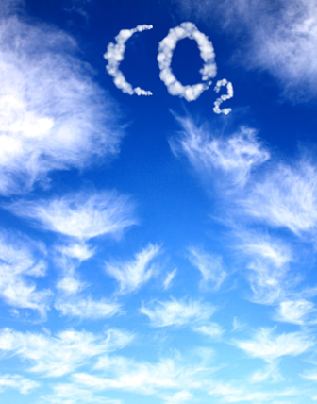
Overview
Chemistry of The Atmosphere
The composition and evolution of the Earth’s atmosphere
  The proportions of different gases in the
  atmosphere
  The Earth’s early atmosphere
  How oxygen increased
  How carbon dioxide decreased
Carbon dioxide and methane as greenhouse
gases
  Greenhouse gases
  Human activities which contribute to an
  increase in greenhouse gases in the atmosphere
  Global climate change
  The carbon footprint and it’s reduction
Common atmospheric pollutants and their
sources
Atmospheric pollutants from fuels
Properties and effects of atmospheric pollutants

Slide 3
LearnIT!
KnowIT!
The composition and
evolution of the Earth’s
Atmosphere
Part 1
  The proportion of different
  gases in the atmosphere
  The Earth’s early atmosphere

Slide 4

  The proportions of different gases in the atmosphere
For 200 million years, the proportions of different gases in the atmosphere have been much the same as they are today:
about four-fifths (approximately 80%) nitrogen
about one-fifth (approximately 20%) oxygen
small proportions of various other gases, including carbon dioxide, water vapour and noble gases.
You must learn these percentages for the exam
80% N₂
20% O₂
<1% CO₂, H₂O + Noble Gases

Slide 5

  The Earth’s early atmosphere
Theories about what was in the Earth’s early atmosphere and how the atmosphere was formed have changed and developed over time. Evidence for the early atmosphere is limited because of the time scale of 4.6 billion years.
There are a number of different theories as to how the atmosphere evolved.
One theory suggests:
During the first billion years there was intense volcanic activity that released gases that formed the early atmosphere consisting of mainly carbon dioxide with little or no oxygen gas.
Water vapour condensed to form the oceans.
Volcanoes also produced nitrogen which gradually built up in the atmosphere and there may have been small proportions of methane and ammonia.
When the oceans formed, carbon dioxide dissolved in the water and carbonates were precipitated producing sediments, reducing the amount of carbon dioxide in the atmosphere.
CO₂, N₂, H₂O

Slide 6
QuestionIT!
The composition and
evolution of the Earth’s
Atmosphere (Part 1)
  The proportion of different
  gases in the atmosphere
  The Earth’s early atmosphere

Slide 7
  The composition and evolution of the Earth’s atmosphere Part 1– QuestionIT
Name 4 gases in the Earth’s atmosphere.
Give the proportions of gases in the Earth’s atmosphere.
Why is evidence for the Earth’s early atmosphere limited?
What gases are believed to have been released from volcanoes during the first billion years of the Earth’s existence?

Slide 8
  The composition and evolution of the Earth’s atmosphere Part 1– QuestionIT
How did the oceans form?
Why did the amount of carbon dioxide in the earlier atmosphere decrease?
What gas in the current day atmosphere was not present in the atmosphere 4.6 billion years ago?

Slide 9

AnswerIT!
The composition and
evolution of the Earth’s
Atmosphere (Part 1)
  The proportion of different
  gases in the atmosphere
  The Earth’s early atmosphere

Slide 10
  The composition and evolution of the Earth’s atmosphere Part 1– QuestionIT
Name 4 gases in the Earth’s atmosphere.
  Nitrogen, oxygen, other gases such as carbon dioxide, water vapour and noble gases.
Give the proportions of gases in the Earth’s atmosphere.
  Nitrogen 80%; Oxygen 20%; small proportions of other gases.
Why is evidence for the Earth’s early atmosphere limited?
  The timescale of 4.6 billion years.
What gases are believed to have been released from volcanoes during the first billion years of the Earth’s existence?
  Nitrogen, carbon dioxide, water vapour; small amounts of ammonia and methane.

Slide 11
  The composition and evolution of the Earth’s atmosphere Part 1– QuestionIT
How did the oceans form?
  Water vapour in the atmosphere condensed.
Why did the amount of carbon dioxide in the earlier atmosphere decrease?
  When oceans formed carbon dioxide dissolved in the water; carbonates precipitated producing sediments, reducing carbon dioxide in the atmosphere.
What gas in the current day atmosphere was not present in the atmosphere 4.6 billion years ago?
  Oxygen.

Slide 12
LearnIT!
KnowIT!
The composition and
evolution of the Earth’s
Atmosphere
Part 2
How oxygen increased
How carbon dioxide decreased

Slide 13
  How oxygen increased and carbon dioxide decreased
Organisms evolved that changed the atmosphere in a significant way.
Algae and plants produced the oxygen that is now in the atmosphere by photosynthesis, which can be represented by the equation:
6CO₂ + 6H₂O C₆H₁₂O₆ + 6O₂
Carbon dioxide + water glucose + oxygen
light
Algae first produced oxygen about 2.7 billion years ago and soon after this oxygen appeared in the atmosphere. Over the next billion years plants evolved and the percentage of oxygen gradually increased to a level that enabled animals to evolve.
Algae and plants decreased the percentage of carbon dioxide in the atmosphere by photosynthesis. Carbon dioxide was also decreased by the formation of sedimentary rocks and fossil fuels that contain carbon.
Oxygen increases due to photosynthesis.
Carbon dioxide decreases due to photosynthesis, formation of sedimentary rocks and fossil fuels.

Slide 14
QuestionIT!
The composition and
evolution of the Earth’s
Atmosphere
Part 2
How oxygen increased
How carbon dioxide decreased

Slide 15
  How oxygen increased and carbon dioxide decreased - QuestionIT
What organisms increased the amount of oxygen in the Earth’s atmosphere?
Write the balanced symbol equation for photosynthesis.
When did oxygen first start appearing in the atmosphere and which organism was responsible?
Other than photosynthesis what other factors decreased the level of carbon dioxide in the atmosphere?
Describe the main changes to the atmosphere over time and the likely causes of these changes.

Slide 16
AnswerIT!
The composition and
evolution of the Earth’s
Atmosphere
Part 2
How oxygen increased
How carbon dioxide decreased

Slide 17
  How oxygen increased and carbon dioxide decreased - QuestionIT
What organisms increased the amount of oxygen in the Earth’s atmosphere?
  Algae and plants.
Write the balanced symbol equation for photosynthesis.
  6CO₂ + 6H₂O C₆H₁₂O₆ + 6O₂
When did oxygen first start appearing in the atmosphere and which organism was responsible?
  2.7 billion years ago; algae.
Other than photosynthesis what other factors decreased the level of carbon dioxide in the atmosphere?
  Formation of sedimentary rocks and fossil fuels (natural gas, oil, coal).

Slide 18
  How oxygen increased and carbon dioxide decreased - QuestionIT
Describe the main changes to the atmosphere over time and the likely causes of these changes.
  Intense volcanic activity – water vapour, carbon dioxide, nitrogen, ammonia, methane released.
  Water vapour condensed to form oceans.
  Atmosphere mostly carbon dioxide; nitrogen slowly building up over time.
  Carbon dioxide dissolved in oceans; carbonates precipitated producing sediments. Carbon dioxide levels in atmosphere drop.
  Photosynthesis – algae produce oxygen.
  Plants evolved, levels of carbon dioxide reduced, levels of oxygen increased; animals evolved.
  Carbon dioxide levels dropped during the formation of sedimentary rock (from sediments) and fossil fuels (from organisms).

Slide 19
LearnIT!
KnowIT!
Carbon dioxide and methane as greenhouse
Gases Part 1
Greenhouse gases
Human activities which contribute to an increase in greenhouse gases in the atmosphere

Slide 20

  Carbon dioxide and methane as greenhouse gases
Greenhouse gases in the atmosphere maintain temperatures on Earth high enough to support life. Examples of greenhouse gases are:
Carbon dioxide
Water vapour
Methane
You must know these three gases
CO₂
Visible light
Infra-red
Trapped in atmosphere warming it up
Absorbed then re-radiated
Infra-red
Visible light with a short wavelength is absorbed by the Earth, it is then re-radiated as longer wavelength infra red.
The longer wavelength infra red cannot penetrate through the greenhouse gas layer in the atmosphere which contains carbon dioxide and methane.

Slide 21
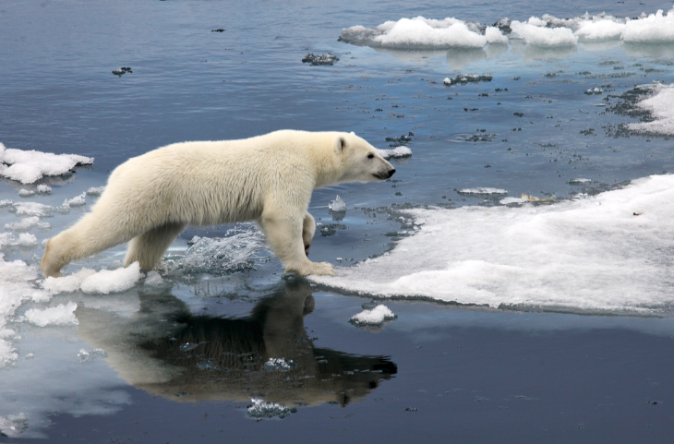
  Carbon dioxide and methane as greenhouse gases
Some human activities increase the amounts of greenhouse gases in the atmosphere namely carbon dioxide and methane.
Two human activities that increase the amount of the greenhouse gas carbon dioxide are burning fossil fuels and deforestation.
Two human activities that increase the amount of the greenhouse gas methane are farming of livestock e.g. cows and pigs and landfills.
Based on peer-reviewed evidence, many scientists believe that human activities will cause the temperature of the Earth’s atmosphere to increase at the surface and that this will result in global climate change.
However it is difficult to model such complex systems as global climate change. This leads to simplified models, speculation and opinions presented in the media that may be based on only parts of the evidence and which may be biased.

Slide 22
QuestionIT!
Carbon dioxide and
methane as greenhouse
Gases Part 1
Greenhouse gases
Human activities which contribute to an increase in greenhouse gases in the atmosphere

Slide 23
  Carbon dioxide and methane as greenhouse gases – QuestionIT
Name 3 greenhouse gases.
What is the link between greenhouse gases and the temperature of the Earth?
Name human activities which increase the amount of carbon dioxide in the atmosphere.
Name human activities that increase the amount of methane in the atmosphere.

Slide 24
  Carbon dioxide and methane as greenhouse gases – QuestionIT
What do many scientists believe about human activities and the temperature of the Earth’s atmosphere?
Why are there issues surrounding modelling human impact on climate change?

Slide 25
AnswerIT!
Carbon dioxide and
methane as greenhouse
Gases Part 1
Greenhouse gases
Human activities which contribute to an increase in greenhouse gases
in the atmosphere

Slide 26
  Carbon dioxide and methane as greenhouse gases – QuestionIT
Name 3 greenhouse gases.
  Water vapour, carbon dioxide, methane.
What is the link between greenhouse gases and the temperature of the Earth?
  Greenhouse gases maintain temperatures on the Earth high enough to support life.
Name human activities which increase the amount of carbon dioxide in the atmosphere.
  Burning/ combustion of fossil fuels, deforestation.
Name human activities that increase the amount of methane in the atmosphere.
  Farming of livestock; landfill sites.

Slide 27
  Carbon dioxide and methane as greenhouse gases – QuestionIT
What do many scientists believe about human activities and the temperature of the Earth’s atmosphere?
  Human activities will cause the temperature of the Earth’s atmosphere to increase at the surface resulting in climate change.
Why are there issues surrounding modelling human impact on climate change?
  It is difficult to model these changes
  Simplified models are generated
  Leading to speculation and opinions presented in the media that may be based on only part of the evidence and be biased.

Slide 28
LearnIT!
KnowIT!
Carbon dioxide and methane as greenhouse
Gases Part 2
Global climate change
The carbon footprint and its reduction

Slide 29
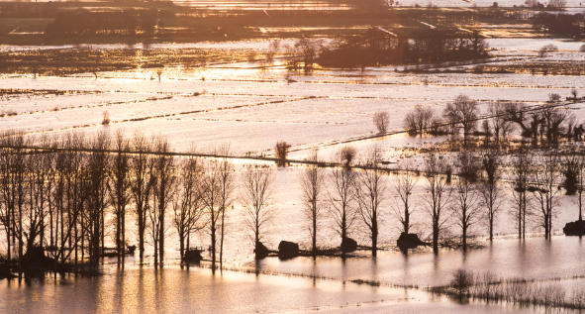
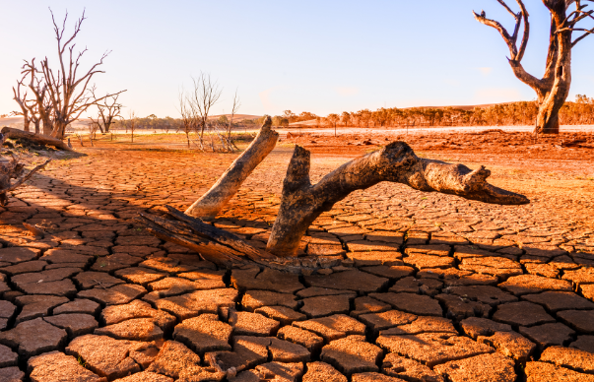

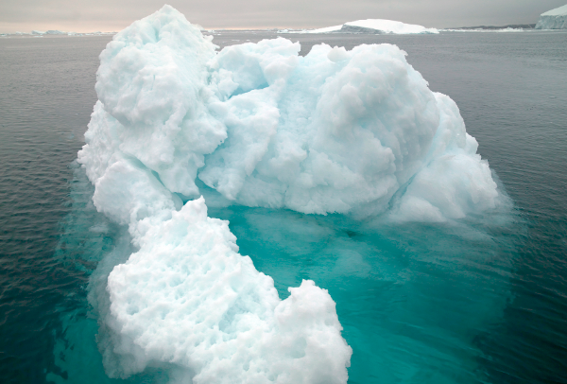
  Global climate change the carbon footprint and its reduction
An increase in average global temperature is a major cause of climate change.
There are a number of potential effects of climate change:
Rising sea levels causing flooding
Droughts
Desertification
Ice caps melting
The carbon footprint is the total amount of carbon dioxide and other greenhouse gases emitted over the full life cycle of the product, service or event. The carbon footprint can be reduced by reducing emissions of carbon dioxide and methane.

Slide 30
QuestionIT!
Carbon dioxide and methane as greenhouse
Gases Part 2
Global climate change
The carbon footprint
and its reduction

Slide 31
  Global climate change the carbon footprint and its reduction - AnswerIT
What is a major cause of climate change?
Give three possible effects of climate change.
What is the carbon footprint?
How can the carbon footprint be reduced?

Slide 32
AnswerIT!
Carbon dioxide and methane as greenhouse
Gases Part 2
Global climate change
The carbon footprint
and its reduction

Slide 33
  Global climate change the carbon footprint and its reduction - AnswerIT
What is a major cause of climate change?
  An increase in average global temperature
Give three possible effects of climate change.
  Droughts/desertification/flooding/ice caps melting
What is the carbon footprint?
  The total amount of carbon dioxide and other greenhouse gases emitted over the full life cycle of a product, service or event.
How can the carbon footprint be reduced?
  By reducing emissions of carbon dioxide and ethane.

Slide 34
LearnIT!
KnowIT!
Common atmospheric
pollutants and their sources
Atmospheric pollutants from fuels
Properties and effects of atmospheric pollutants

Slide 35
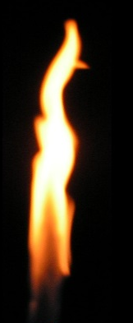

  Common atmospheric pollutants and their sources
The combustion of fuels is a major source of atmospheric pollutants.
Most fuels, including coal, contain carbon and/or hydrogen and may also contain some sulfur.
Incomplete combustion of these fuels causes carbon monoxide and soot (carbon particles) to be produced.
Complete combustion of these fuels produces Carbon dioxide.
As there are small amounts of sulfur and nitrogen in the fuels, these also oxidise to sulfur dioxide and oxides of nitrogen which are also pollutants.

Slide 36
  Common atmospheric pollutants and their sources
The gases released in to the atmosphere when a fuel is burnt may include carbon dioxide, water vapour, carbon monoxide, sulfur dioxide and oxides of nitrogen. Solid particles and unburned hydrocarbons may also be released that forms particulates in the atmosphere.
Carbon monoxide is a toxic gas. It is colourless and odourless and so is not easily detected.
Sulfur dioxide and oxides of nitrogen cause respiratory problems in humans and cause acid rain.
Particulates cause global dimming and health problems in humans.

Slide 37
QuestionIT!
Common atmospheric
pollutants and their
sources
Atmospheric pollutants
from fuels
Properties and effects of atmospheric pollutants

Slide 38
  Common atmospheric pollutants and their sources - QuestionIT
What are the two main elements in most fuels?
What other potentially polluting element may be present in fossil fuels?
What gases may be released into the atmosphere when a fuel is burned?
Which two of these gases can lead to acid rain?
What else may be released, during combustion of fuels, to form particulates in the atmosphere?

Slide 39
  Common atmospheric pollutants and their sources - QuestionIT
Write the balanced symbol equation for the complete combustion of pentane C₅H₁₂ .
Which two substances would be formed if this was an incomplete combustion reaction?
Describe the gas carbon monoxide.
Why is carbon monoxide difficult to detect?
What are two effects of sulfur dioxide in the atmosphere?
What are two effects of particulates in the atmosphere?

Slide 40
AnswerIT!
Common atmospheric
pollutants and their
sources
Atmospheric pollutants
from fuels
Properties and effects of atmospheric pollutants

Slide 41
  Common atmospheric pollutants and their sources - QuestionIT
What are the two main elements in most fuels?
  Hydrogen and carbon.
What other potentially polluting element may be present in fossil fuels?
  Sulfur.
What gases may be released into the atmosphere when a fuel is burned?
  Carbon dioxide, water vapour, carbon monoxide, sulfur dioxide and oxides of nitrogen.
Which two of these gases can lead to acid rain?
  Sulfur dioxide, oxides of nitrogen.
What else may be released, during combustion of fuels, to form particulates in the atmosphere?
  Solid particulates, unburned hydrocarbons.

Slide 42
  Common atmospheric pollutants and their sources - QuestionIT
Write the balanced symbol equation for the complete combustion of pentane C₅H₁₂ .
  C₅H₁₂ + 8O₂ 5CO₂ + 6H₂O
Which two substances would be formed if this was an incomplete combustion reaction?
  Water and carbon monoxide and/ or soot
Describe the gas carbon monoxide.
  Toxic gas; colourless and odourless.
Why is carbon monoxide difficult to detect?
  Colourless and odourless.
What are two effects of sulfur dioxide in the atmosphere?
  Respiratory problems in humans; acid rain.
What are two effects of particulates in the atmosphere?
  Global dimming; health problems for humans.

